Slide 1
Cloud Computing 04-28-2024 Group 8 Jagadeeshwar Kalyanapu Kundanachowdary Cherukuri Swathi Kannetti Ramana Reddy
Sentiment Analysis using AWS Comprehend

Slide 2

Introduction to Sentiment Analysis

Slide 3

AWS Lambda – The Backbone of Our Architecture
Code
Central Role of AWS Lambda
Event-Driven Trigger
Data Preparation Task
Initiating Sentiment Analysis
Scalability and Efficiency
Notes:
Explain the role of AWS Lambda in your architecture.
Describe how the Lambda function is triggered and its task of reading and preparing the data for sentiment analysis.
Central Role of AWS Lambda
Acts as a serverless compute service executing code in response to events.
Automates the workflow by triggering functions for specific conditions.
Integrates with AWS services seamlessly to create a responsive data pipeline.
Event-Driven Trigger
Triggered by Amazon S3 upon the upload of new data (e.g., customer reviews in 'reviews.csv' or 'reviews.txt').
S3 Event Notifications are configured to invoke the Lambda function automatically.
Data Preparation Task
Reads input data from the S3 bucket ('projectsentimentanalysis').
Parses and processes text files (such as 'reviewsfinal.txt'), preparing them for analysis.
Handles data cleanup, removing unnecessary characters, and standardizing formats.
Initiating Sentiment Analysis
Sends the prepared data to AWS Comprehend for sentiment analysis.
The output from Comprehend is then stored in DynamoDB for persistence and quick access.
Scalability and Efficiency
Only runs when needed, scaling automatically with the size of the workload.
Optimizes resource use and keeps operational costs low.

Slide 4

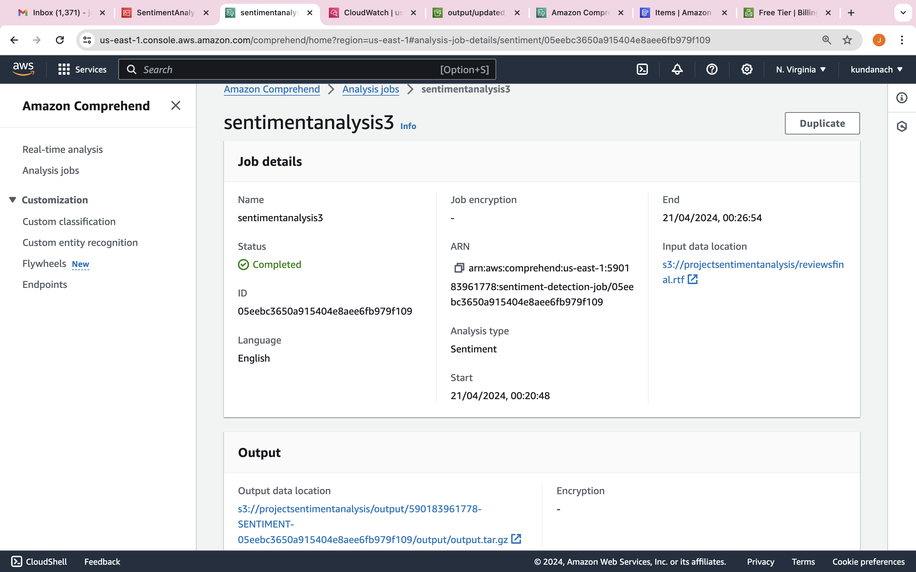
Harnessing AWS Comprehend for Sentiment Analysis
Code
Overview of AWS Comprehend
Sentiment Analysis with AWS Comprehend
Input Data
Processing Data
Output Data
Use Cases and Examples
Notes:
Overview of AWS Comprehend
Define AWS Comprehend as a natural language processing (NLP) service that uses machine learning to find insights and relationships in a text.
Explain that it automatically identifies the language of the text and extracts key phrases, places, people, brands, or events.
Sentiment Analysis with AWS Comprehend
Describe sentiment analysis as the process of determining whether a piece of writing is positive, negative, neutral, or mixed.
Detail how AWS Comprehend detects sentiment by using pre-trained models.
Input Data
Discuss the nature of input data suitable for AWS Comprehend, which typically includes social media posts, customer reviews, and other text sources.
Mention any pre-processing steps required, like removing special characters or unnecessary whitespace.
Processing Data
Outline the process of sending text to AWS Comprehend via the AWS Management Console, AWS SDKs, or the AWS Command Line Interface (CLI).
Mention that AWS Comprehend can process a large batch of documents stored in Amazon S3 or single documents in real-time.
Output Data
Explain the output of sentiment analysis which includes a sentiment label (POSITIVE, NEGATIVE, NEUTRAL, MIXED) and a confidence score for each sentiment.
Present how this output can be used to gauge customer sentiment, monitor brand reputation, and understand user responses.
Use Cases and Examples
Provide examples of sentiment analysis, like analyzing customer feedback on a new product launch or assessing social media perception during a marketing campaign.
Use case studies or hypothetical scenarios to illustrate how businesses leverage Comprehend for sentiment analysis.

Slide 5

Visualizing Sentiment Analysis with AWS QuickSight
Code
QuickSight Overview
Sentiment Distribution
Data Interpretation
Interactivity Features
Use Case Demonstration
Notes:
QuickSight Overview
AWS QuickSight provides an interactive user interface for visualizing data.
Enables dynamic data visualization from AWS services like S3 and Comprehend.
Sentiment Distribution
Display a bar graph showing the number of records for each sentiment classification (Positive, Negative, Neutral).
Highlight which sentiment is the most prevalent across all data points.
Data Interpretation
Discuss the implications of the dominant sentiment on business decision-making.
Analyze trends and outliers within the sentiment data.
Interactivity Features
Explain how users can interact with the visualizations to filter and drill down into specific data points.
QuickSight's dashboard allows for real-time analysis, facilitating instant insights.
Use Case Demonstration
Present a case study or example where the visualized data led to actionable insights.
Highlight a specific product or service category and its sentiment breakdown to showcase the depth of analysis possible.

Slide 6
Sentiment Analysis : A Categorical Breakdown
Code
Category-Wise Sentiment Distribution
Sentiment Implications per Category
Category-Specific Trends and Insights
Actionable Insights
Comparative Analysis
Notes:
Category-Wise Sentiment Distribution
Illustrate the sentiment distribution for different product or service categories using horizontal bar charts or other appropriate graphs.
Emphasize the volume of feedback in each sentiment category for every product or service.
Sentiment Implications per Category
Explain what a higher prevalence of positive or negative sentiments indicates for each category.
Discuss how neutral sentiments could imply satisfaction but also a lack of strong customer engagement or loyalty.
Category-Specific Trends and Insights
Identify any patterns or outliers, such as a product category with overwhelmingly positive feedback or one with mixed sentiments.
Hypothesize reasons for these trends based on product features, service quality, or market conditions.
Actionable Insights
Suggest strategies for improving customer satisfaction based on sentiment analysis, such as enhancing product features or addressing service issues.
Discuss how businesses can leverage positive sentiments in marketing and product development.
Comparative Analysis
Compare sentiment across categories to identify leaders and laggards in terms of customer sentiment.
Determine the effectiveness of different business strategies based on customer feedback.

Slide 7

Amazon S3 Robust and Secure Storage Solution
Code
Role in Project Architecture
Data Lifecycle Management
Security Features
Scalability and Availability
Integration with AWS Services
Performance and Efficiency
Notes:
Role in Project Architecture
S3 as the starting point Storing raw customer reviews and other input data.
End-point for processed data Storing the output of sentiment analysis.
Data Lifecycle Management
Explain how S3 organizes data in buckets and objects, with lifecycle policies to manage data through its lifecycle from upload to archive or deletion.
Security Features
Data encryption in transit and at rest to ensure data protection.
Fine-grained access controls, including bucket policies and AWS Identity and Access Management (IAM) to restrict access to sensitive data.
Scalability and Availability
Unlimited storage with pay-as-you-go pricing, allowing the project to scale as data grows.
High availability and durability, guaranteeing 99.999999999% (11 9's) of durability.
Integration with AWS Services
Seamless integration with other AWS services like Lambda for automated data processing and AWS Comprehend for sentiment analysis.
Enables event-driven computing by triggering functions or workflows based on data changes in S3.
Performance and Efficiency
High-speed performance suitable for big data analytics.
Offers storage classes for different use cases to optimize cost and performance.

Slide 8
Configuring AWS Lambda for Seamless Integration
Code
Lambda Function Setup
Event Trigger and Sources
Permissions and Role
Communication with AWS Services
Monitoring and Logs
Notes:
Lambda Function Setup
Define the function's runtime environment (e.g., Python, Node.js) and its associated execution role.
Mention the function's memory allocation, timeout settings, and environment variables that are specific to your project.
Event Triggers and Sources
Describe how the Lambda function is triggered by Amazon S3 events, such as PUT or POST, indicating new data uploads.
Explain other possible triggers like AWS API Gateway for HTTP endpoints or AWS CloudWatch for scheduled events.
Permissions and Role
Discuss the IAM role associated with the Lambda function which grants necessary permissions to access other AWS services.
Mention specific policies attached to the role, such as AmazonDynamoDBFullAccess, AmazonS3FullAccess, AWSLambdaExecute, which allow the function to interact with DynamoDB, S3, and manage its logs and metrics.
Communication with AWS Services
Detail how the function uses AWS SDKs to interact with services like Amazon S3 for data retrieval and AWS Comprehend for sentiment analysis.
Explain how Lambda writes results to AWS DynamoDB and publishes messages to SNS topics or sends data to AWS QuickSight for visualization.
Monitoring and Logs
Mention integration with AWS CloudWatch for monitoring function invocations, logging its activities, and capturing errors.
Discuss how logs and metrics are used to track the function’s performance and diagnose issues.

Slide 9
The Crucial Role of IAM in AWS Security
Code
Access Management
Fine-Grained Permissions
IAM Policies
Security Best Practices
Audit and Compliance
Integration with Other AWS Services
Notes:
Access Management
IAM allows you to manage access to AWS services and resources securely.
Users, groups, and roles can be precisely defined with specific permissions to control who can interact with which AWS resources.
Fine-Grained Permissions
Explain how IAM enables granular permissions to allow only the necessary actions needed by a user or service, following the principle of least privilege.
Example The Lambda function has just enough access rights to perform sentiment analysis and store results, but not more.
IAM Policies
Discuss the use of policies to define permissions, which can be attached to users, groups, or roles.
Highlight the use of managed policies versus custom policies tailored to your project’s specific needs.
Security Best Practices
Mention the best practices such as regular reviews of IAM permissions, use of MFA (Multi-Factor Authentication), and rotation of access keys.
Describe how IAM roles avoid the need to share security credentials, instead granting permissions to the role that the AWS service can assume.
Audit and Compliance
IAM supports compliance with auditing capabilities. AWS CloudTrail, for example, allows you to log and retain account activity related to actions across your AWS infrastructure.
Integration with Other AWS Services
Show how IAM is integrated into the AWS ecosystem, ensuring that all AWS services operate with a consistent and secure authentication mechanism.

Slide 10
IAM Permissions Empowering Lambda and Comprehend
Code
IAM Role for Lambda
Example policies
IAM Role for Comprehend
Example policy
Permission Boundaries
Cross-Service Interaction
Policy Best Practices
Notes:
IAM Role for Lambda
Discuss the IAM role specifically created for the Lambda function which includes permissions to interact with other AWS services.
Example policies
AWSLambdaBasicExecutionRole – Allows Lambda functions to call AWS services on your behalf and write logs to CloudWatch.
AmazonS3ReadOnlyAccess – Grants the Lambda function read-only access to S3 resources.
IAM Role for Comprehend
Outline the permissions that AWS Comprehend requires to access data and perform analysis.
Example policy
ComprehendReadOnly – Enables AWS Comprehend to read text data from the specified S3 buckets.
Permission Boundaries
Explain how permission boundaries are used to delegate administration by defining the maximum permissions IAM roles can have.
Ensure that the Lambda function and AWS Comprehend can only access necessary resources to maintain security.
Cross-Service Interaction
Detail how the Lambda function uses these permissions to retrieve data from S3, send it to Comprehend, and then store the results in DynamoDB or S3.
Mention any specific permissions that allow Lambda to invoke Comprehend and how results are passed securely between services.
Policy Best Practices
Emphasize the importance of regularly reviewing and updating IAM policies to reflect changes in your project or AWS best practices.
Discuss the advantage of using managed policies for ease of use and custom policies for finer control.

Slide 11
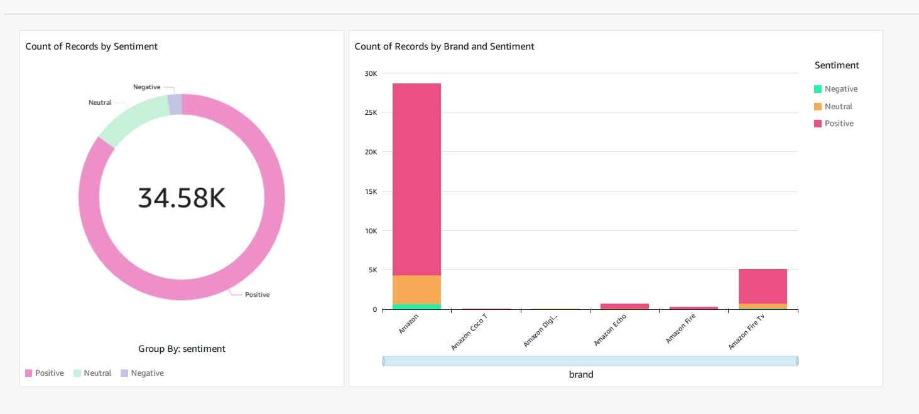
Output Visualization

Slide 12
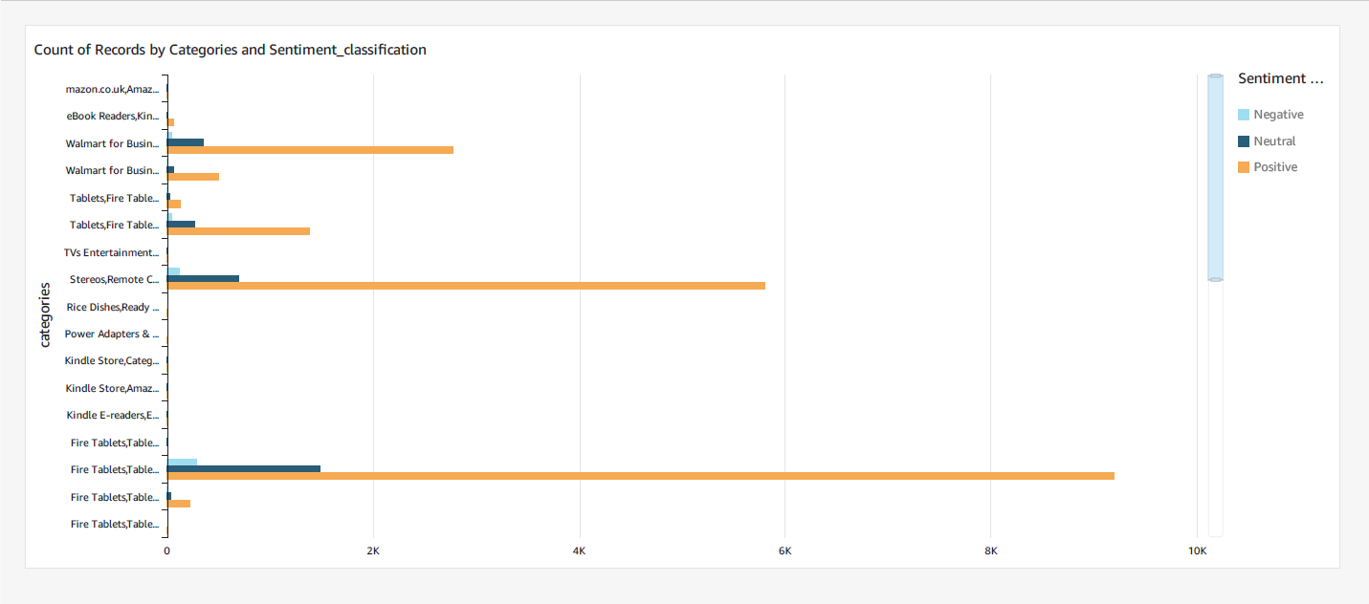

Slide 13

Conclusion
CONCLUSION
Successful Integration and Automation
Actionable Business Insights
Scalability and Security
Notes:
1. Successful Integration and Automation
We successfully implemented an automated sentiment analysis system using a suite of AWS services. This streamlined workflow showcases our ability to harness cloud computing for advanced data processing tasks, reducing manual effort and increasing efficiency.
2. Actionable Business Insights
Our project's core achievement is transforming raw customer feedback into actionable insights. By analyzing sentiment trends, businesses can make informed decisions to improve customer satisfaction and tailor their products or services to meet market demands.
3. Scalability and Security
The scalability and security of AWS infrastructure allowed us to manage large data volumes securely. Leveraging IAM roles and permissions ensured that each service operated within a secure environment, crucial for maintaining data integrity and trust in cloud-based systems.

